Slide 1
Migration and Development
State of the Art
Rabat Process
Madrid, Spain
12-13 May 2022
Jason GAGNON
Head of Unit
Migration and Skills
OECD Development Centre
Notes:
ndps
skills and mobility
diaspora\remittances\FDI

Slide 2
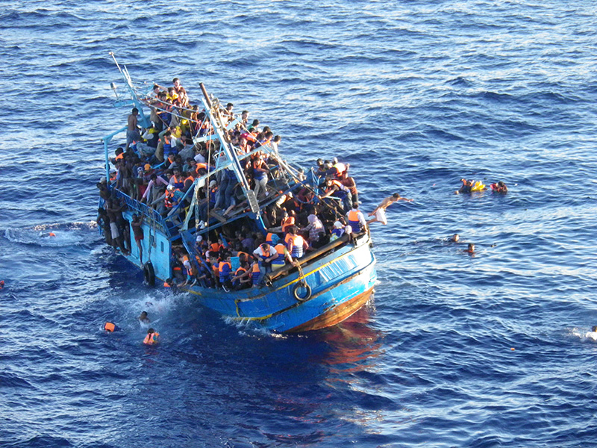

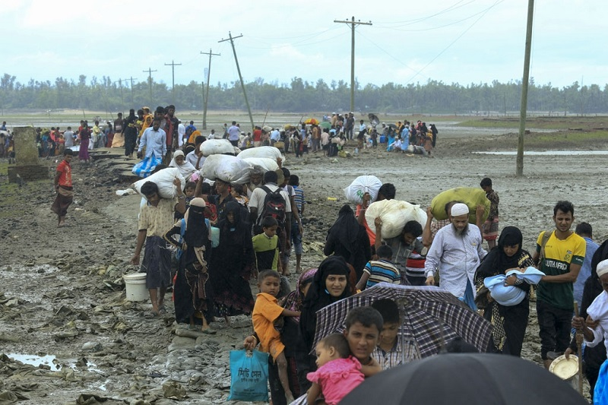

International migration and development: a challenging context

Slide 3




But also encouraging policy responses
Global Compact on Safe, Regular and Orderly Migration
Global Compact on Refugees

Slide 4
How does migration contribute to development?
In origin countries
Emigration acts as a safety valve for the labour market
Remittances represent a source of finance for development
Diasporas are an enabler for social development
Brain circulation helps strengthen human capital & innovation
Invest in the development of skills in origin countries to foster the acumulation of human capital
Help reduce remittance costs and invest in financial training
Fund diaspora projects in countries of origin
Develop return programmes oriented towards productive investment

Slide 5
Migration can also contribute to enhancing the development impact of immigration
In destination countries
Immigration helps reduce skills mismatches
Immigrants expand the domestic market
Immigrants contribute to financing social protection systems
Immigration can lead to increased innovation & entrepreneurship
Support education and invest in social protection & health services to foster the integration of immigrants in destination countries

Slide 6
Key questions on migration and development
In which direction are the trends heading?
How much are these issues considered in development planning?
What to prioritise?

Slide 7
Not all the countries follow the same migration trajectory
Country characteristics (border, language, colonial ties…)
Institutions
Migration policies
Sectoral policies (agriculture, labour market, education, social protection…)
Emigration rate
Different migration trajectories
MT2
MT1
MT3
GDP/capita

Slide 8
Economic growth has spread relatively more emigration than immigration
Cumulative distribution functions for emigration and immigration
Source: Authors' calculations, based on data from World Bank (2018b, 2018c).

Slide 9
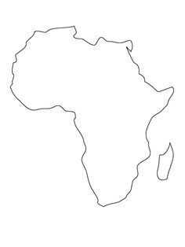

Migration is highly regional
13%
72%
79%
71%
52%

Slide 10
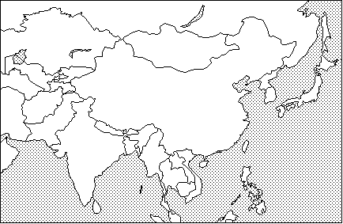
Emigration rate are relatively low in some regions
    World average: 3.4%
    Northern Africa: 4.8%
    Central America (including Mexico): 9.7%
2.5%
2.1%
3.2%
Notes:
What distinguishes Africa, is the high rate of intraregional emigration
In 2017, 53% of African emigrants were living in another country in Africa
Unpacking that figure shows that the share is much higher within Sub-Saharan Africa (71%)
71% in Eastern Africa
72% in Western Africa
79% in Middle Africa
The rate of intraregional migration in Africa is decreasing
Whereas most African emigrants were still found in Africa in 2017, the rate was higher in 1990 (66%), and has been steadily declining
This is even more evident when observing sub-regional migration rates, which were as high as 86% in Eastern and Western Africa in 1990

Slide 11
Is Migration Prioritised?
Reference to migration in national development plans is low
Countries address migration in silos
The migration narrative adopted by countries varies greatly
The integration of migration issues in NDPs has increased over time, particularly in the 2015 and 2018 period
Few countries link NDPs to global migration-related commitments

Slide 12
What to prioritise?
Skills mobility

Slide 13
Migration is highly regional
13%
72%
79%
71%
52%

Slide 14
What to prioritise?
Skills mobility
How to enable diasporas to contribute to development processes
  Public policies
  Attractivity
  FDI vs. remittances

Slide 15
The importance of remittances as a source of finance varies across regions
USD 630 billion worldwide in 2021

Slide 16
What to prioritise?
Skills mobility
How to enable diasporas to contribute to development processes
  Public policies
  Attractivity
  FDI vs. remittances
Capacity to deal with immigration and integration

Slide 17

Thank you!
www.oecd.org/dev
_jasongagnon

