Slide 1
African Union Visa on Arrival Policy –
The Ghanaian Experience
Presented by:
Assistant Commissioner of Immigration/ Dr. Prosper Asima
Head/ Kotoka International Airport, Accra, Ghana

Slide 2
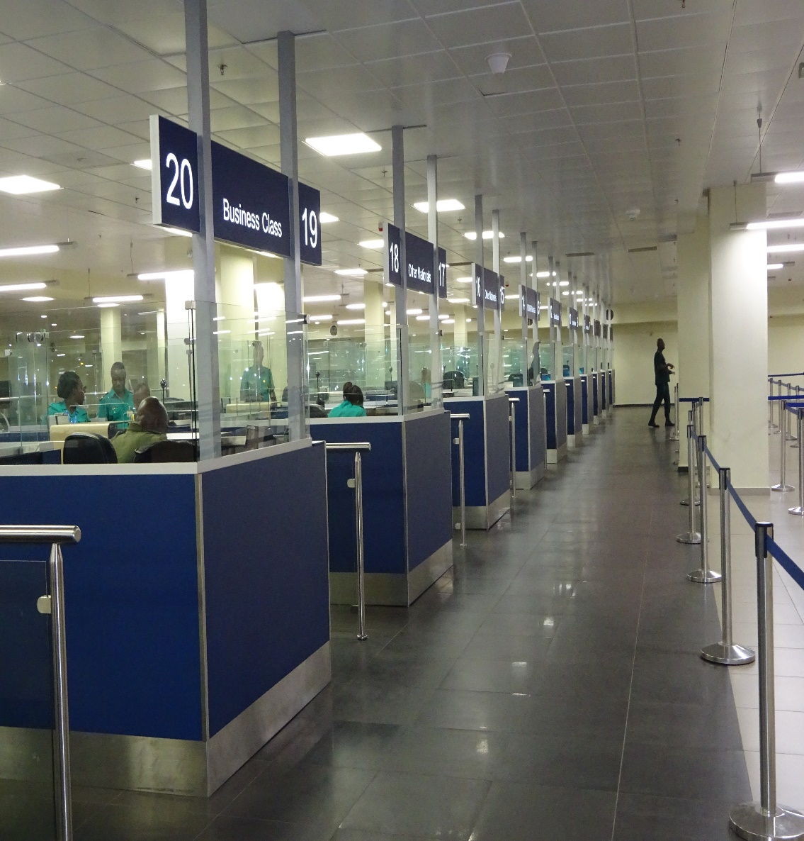
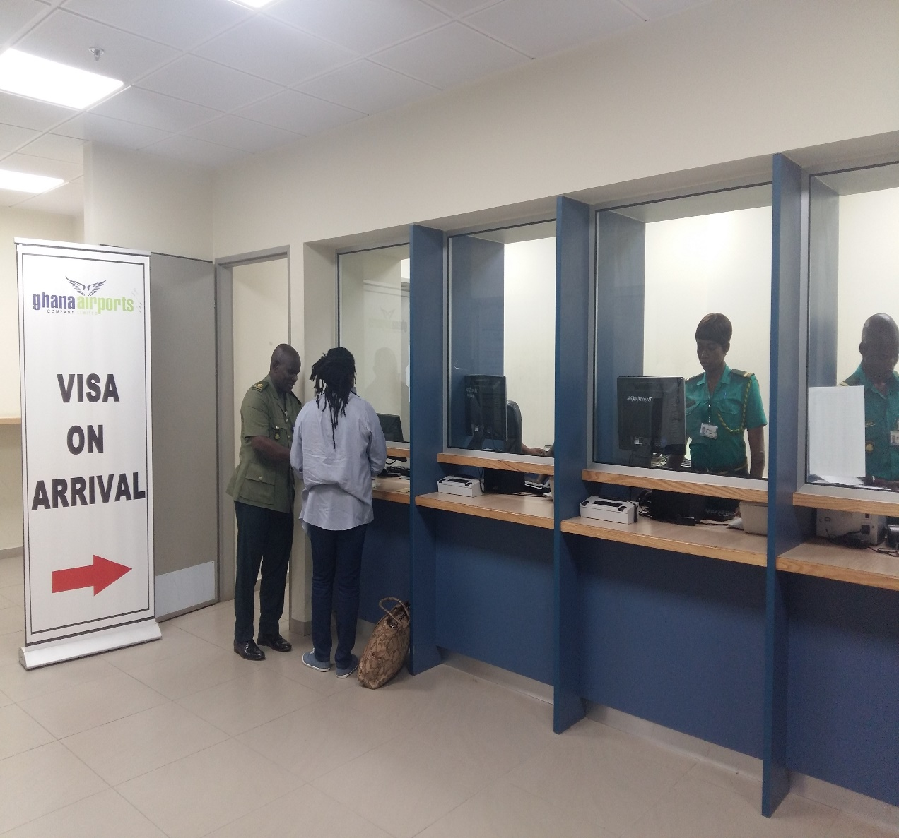
African Union Visa on Arrival Policy –
The Ghanaian Experience

Slide 3
African Union Visa on Arrival Policy –
The Ghanaian Experience
INTRODUCTION
In simple terms, regional integration is a process whereby nation-states agree to promote cooperation.
The objectives range from economic, political, social to environmental and other areas of mutual concern mainly to achieve peace, stability and sustainable development.
Efforts at regional integration have often focused on removing barriers to free trade, free movement of people, labour, goods and capital across national borders, reducing the possibility of regional conflicts and adopting common grounds on policy issues, such as the environment, agriculture, climate change and migration.

Slide 4
African Union Visa on Arrival Policy –
The Ghanaian Experience
Likely gains - new ties and opportunities; increased returns, competition and innovation; investment; coordination and bargaining power; promoting peace, reducing nationalist tensions, security etc.
One approach of deepening regional integration is the free movement of persons and visa facilitation is a means of achieving this goal.
It is in this direction that the African Union Executive Council decided that AU Member States should review their internal and external security situations to allow for the issuance of visa's on arrival for citizens of AU member states.
Also, the 16 priorities of the 2016 Valletta Action Plan also recommends visa facilitation agreements.

Slide 5
African Union Visa on Arrival Policy –
The Ghanaian Experience
DECISION
His Excellency, President John Dramani Mahama, in his State of the Nation address presented to Parliament of the Republic of Ghana on Thursday, February 25, 2016 directed that in line with the principles and ideals that have informed Ghana’s Foreign Policy since independence for a united Africa, Ghana should commence the AU Decision, following Rwanda and others for the issuance of visa's on arrival for citizens of AU member states.
He mentioned that this would lead to the creation of economic opportunities, and would “stimulate air trade, investment and tourism.”

Slide 6
African Union Visa on Arrival Policy –
The Ghanaian Experience
The ‘variable geometry’ approach would allow other countries to join subsequently.
Ghana already belongs to ECOWAS, where free movement has been managed over decades.
States have the responsibility to determine the conditions of entry for non-nationals in their territories, for the protection of their citizenry and national interests, subject to international law requirements.

Slide 7
African Union Visa on Arrival Policy –
The Ghanaian Experience
PROCEDURES
The aim is to achieve a balance between facilitation and the control.
The Ghana Immigration Service (GIS) is the frontline agency responsible for the entry, residence and employment of foreign nationals in Ghana in accordance with the provisions of the Immigration Act (Act 573), 2000.
The basic objectives of Ghana’s Entry visa policy are:
To facilitate the entry of genuine travellers while managing the associated risks; and
To contribute to building strong international links, promoting tourism, investment, and addressing skills shortages

Slide 8
African Union Visa on Arrival Policy –
The Ghanaian Experience
PROCEDURES (cont’d)
Rolled out visa-on-arrival for citizens of 54 African Union (AU) member states on Friday, 1 July, 2016.
All AU nationals who arrive without visas are granted visas
All such visas are issued for a validity of thirty (30) days in the first instance.
Fees - $150.00, to be reviewed downwards next year
Pre-reporting by carriers of passengers: Passenger Name Records (PNR)
Risk profiling techniques are applied to identify individuals
Use of Biometrics

Slide 9
African Union Visa on Arrival Policy –
The Ghanaian Experience
PROCEDURES (cont’d)
Ensuring security measures are tight to prevent possible abuse of the system. Criminal, terrorist and immigration Watch lists/security checks are applied
They are also subject to Section 4 of the Immigration Act, 2000 (Act 573) which applies to all travelers entering Ghana (purpose of visit, duration of visit, maintenance and accommodation etc.)
Pre-screening of arriving passengers
Carrier sanctions are also applied to create legal liabilities for carriers to check passengers. Financial penalties are imposed if they are found carrying inadequately documented persons, $5,000.00. Section 54 (ACT 573) (LI 2228)

Slide 10
African Union Visa on Arrival Policy –
The Ghanaian Experience
PROCEDURES (cont’d)
Stepped up cooperation between agencies working at the borders in information sharing.
Exchange of information and cooperation among neighbouring States
The ‘facilitation-Control’ dilemma (Hampshire 2009) is being addressed through biometric border systems, to target intervention on ‘high-risk’ movements.
Refusal of entry could be based on such grounds as criminality, terrorism, security, public health and other concerns

Slide 11
African Union Visa on Arrival Policy –
The Ghanaian Experience
ANALYSIS
1st July - 31st October, 2016:
The KIA Command has disembarked 1,486 AU nationals as at 31st October, 2016.
718 (48.3%) arrived for business.
259 (17.4%) were disembarked for tourism, holiday and visit.
226 (15.2%) arrived for conferences or meetings.
Most AU nationals still take visas from the missions abroad.
Out of the total 19,253 AU arrivals, for the period, only 1,486 representing 7.7% opted for visa on arrival

Slide 12
African Union Visa on Arrival Policy –
The Ghanaian Experience
COMMENTS FROM BENEFICIARIES
“This policy is time saving, I would have spent weeks at your embassy abroad”
“I am hoping other countries would follow suit, so that we can achieve full integration”
“I attend meetings in Ghana a lot because the headquarters of my company is in Accra, it is now easier for me to come at short notice”.
“Because you have no mission in my country, this was always a bother. This challenge has been removed with this introduction of visa on arrival policy, thanks”.
“It was always a nightmare coming here without a visa, and hoping sometimes that you would not be returned even if you are coming for genuine business. Now this fear is considerably reduced”.

Slide 13
African Union Visa on Arrival Policy –
The Ghanaian Experience
WAY FORWARD
The systems so far has been fair, transparent, and expedient, with accessible information on visa procedures and requirements.
Advance Passenger Information System would be useful
Introducing E-Immigration
E-Gate for facilitation
Need for more publicity - Radio and TV announcements
GIS website
Missions abroad

Slide 14
African Union Visa on Arrival Policy –
The Ghanaian Experience
CONCLUSIONS
Fear of coping with an exodus of migrants
Regional integration could provide valuable opportunities

Slide 15
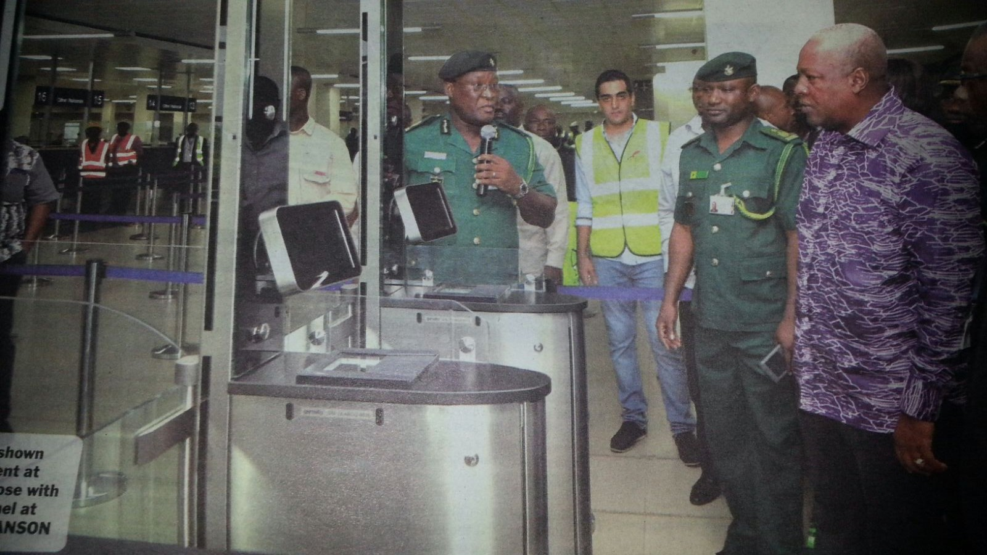
African Union Visa on Arrival Policy –
The Ghanaian Experience
Thank You for your kind attention

