Slide 1
Norwegian experience with the bilateral local border agreement with Russia
Senior Advisor Vibeke Selmer from the Norwegian Ministry of Justice and Public Security
1 December 2016, Praia, Capo Verde

Slide 2
The EU regulation 1931/2006 on local border traffic for external land borders
Into force 19 January 2007 - Historical background:
  29 EU/Schengen countries - common visa and border legislation
  Due to social, cultural, economic reasons, several EU countries had bilateral agreements with neigbouring third countries before entering into EU/Schengen cooperation
  With the introduction of the EU/Schengen cooperation based on a common visa and border legislation, it was a need for a common framework for bilateral agreements
  The EU regulation establishes basic conditions taking in to account national, historical and cultural needs for cross border mobility in neighbouring areas

Slide 3
The EU regulation 1931/2006 on local border traffic for external land borders
Consolidates the EU legal framwork in order to achieve an efficient system for local border crossing
Derogates from the common visa and border legislation
Specifies the basic conditions for bilateral agreements, giving Member States some room for maneuvre to agree further details in their bilateral agreements
The regulation authorises the Member States to conclude or maintain bilateral agreements
Constitutes a balance between the need for easing the border crossing for bona fide border residents having legitimate reasons for frequent border crossing and to prevent illegal immigration and potential threats to security and criminal activities
Shall provide for readmission of persons found to be abusing this regeme

Slide 4
The Norwegian – Russian agreement on border crossing - in force 29 May 2012
30 km «border zone» from the Norwegian-Russian state border
Permit has 3 years validity, but not exceeding the validity of the travel document
Maximum stay is 15 days per visit
No visa-requirement. No entry - exit stamping
The permit does not entitle the holder to work
The permit has same technical specifications as the EU (and Norwegian) residence permit
Issued by the Norwegian Consulate General in Murmansk (Russia)
20 Euros fee. Exemption for minors, students and persons above 60 years of age
One designated border crossing point (Storskog)

Slide 5
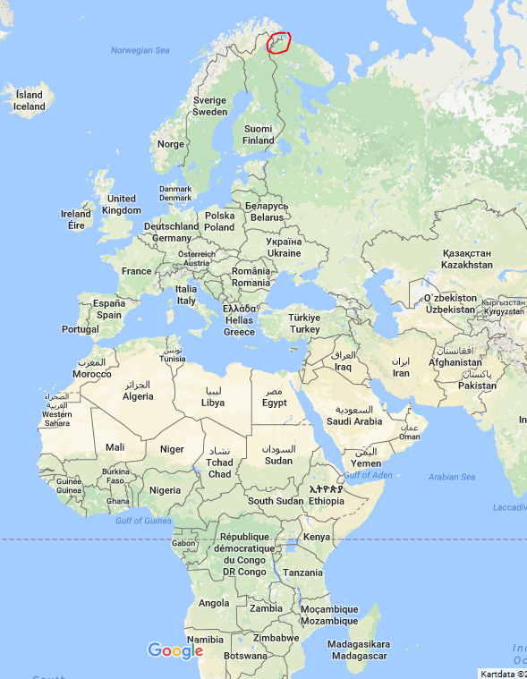
Norwegian border to Russia – 196 km

Slide 6
Conditions for obtaining a Norewegian border crossing permit
Holding a valid travel document
Reside within the «border zone» (30 km territory from the state border)
Having resided in the border zone area for at least the 3 previous preivious
Prove legitimate reasons for the need of frequent border crossing according to this scheeme
Not be a threat to national security, public order or public health

Slide 7
Benefits for the permit holder
Low application fee
Three years validity
Visa free travel
Faster border crossing
No travel insurance requirement
Stay up to 15 consecutive days – no limitations on total amount of days during a year
Permit holders travel for all kinds of purposes

Slide 8
The potential of the regime
More than 50% of the population in the Norwegian border zone already holds a permit (5800 people)
Total 2840 permits issued to Russian border residents
Huge growth potential in Russian border zone. Around 40 - 50 000 persons in the Russian border zone are eligible for a permit. However, the border crossing permit regime has not yet been applied to its maximum in the Russian border zone as many of them already hold a multiple entry visa.

Slide 9
Positive effects and challenges
Important tool to strengthen the ties and cooperation between Norway and Russia
Historical and cultural bands in this area which dates back for centuries, have now been reborn by facilitated people to people contact
Permit holders travel for all kinds of purposes; business, tourism, social life, cultural and sports events
Growth in trade and business – Russians cross the borders for shopping and visiting cafes in Norwegian border zone
No major challanges, but the capacity on the border crossing station had to be reinforced

Slide 10
Norwegian border permit

Slide 11
Thank you for your attention
Vibeke Selmer

